Slide 1



DEVOPS LESSONS FROM EXECUTIVE LEADERSHIP
Why DevOps Matters To Corporate Performance
KEN KENNEDY, President Technology & Product
SCOTT PRUGH, Chief Architect & SVP Engineering // @ScottPrugh

Slide 2
Strategic Mission
We deliver innovative customer engagement solutions that help businesses acquire, monetize, engage and retain customers.
35+
500+
100+
Years of Heritage
Clients Worldwide
Countries
$980m
4,000
$140M
Annual
Revenue
Employees Globally
R&D
Expense

Slide 3
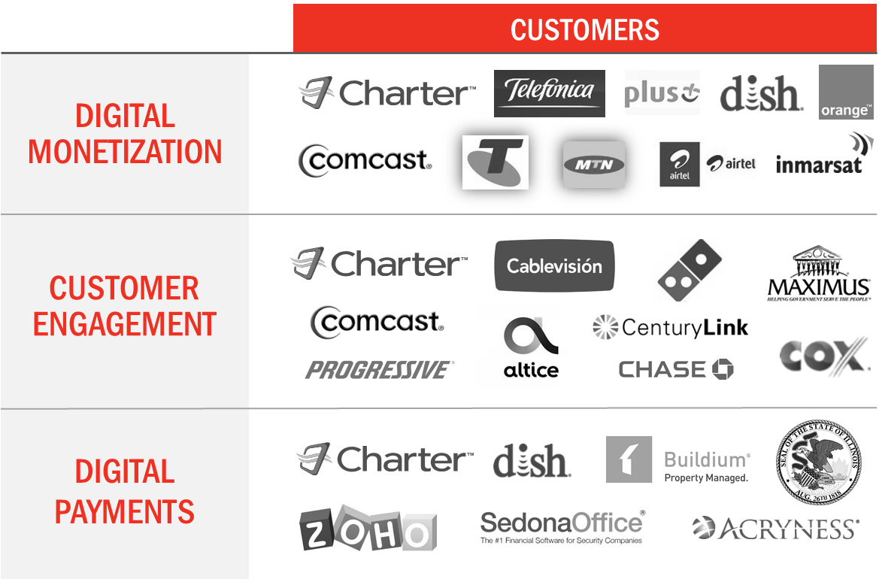
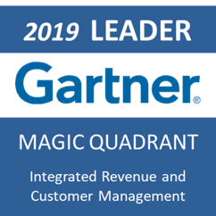
CSG Solutions

Slide 4





Our Journey
Created accountable, cross-functional, high-performing teams
Introduced Lean Portfolio Mgmt. with emphasis on value delivered & flow
Invested in
automation & technology modernization
Achieved faster throughput and significantly improved quality
Fostered a culture of continuous improvement and learning
Notes:
Setting the Table (Ken)
I am incredibly proud of the transformation we’ve experienced at CSG. In the past 14 years, we’ve…
Reorganized to create accountable, cross functional, high performing teams.
Achieved faster throughput while significantly improving quality and stability
Invested in automation and technology modernization.
Rolled out lean product management with an emphasis on optimizing flow (cycle time)
Fostered a culture of continuous improvement and learning
But it has been a journey that included massive shifts in mindset and organizational structures. When I reflect on our journey, I have several moments where we had to make a decision (often unpopular) that required leadership, courage, and influence.
Today, Scott and I would like to share a few of those anecdotes.

Slide 5
People
Process
DOES 2014-2018
Technology & Modernization
Executive
Leadership
DOES 2020
DOES 2019-20
Notes:
Scott: 1min

Slide 6
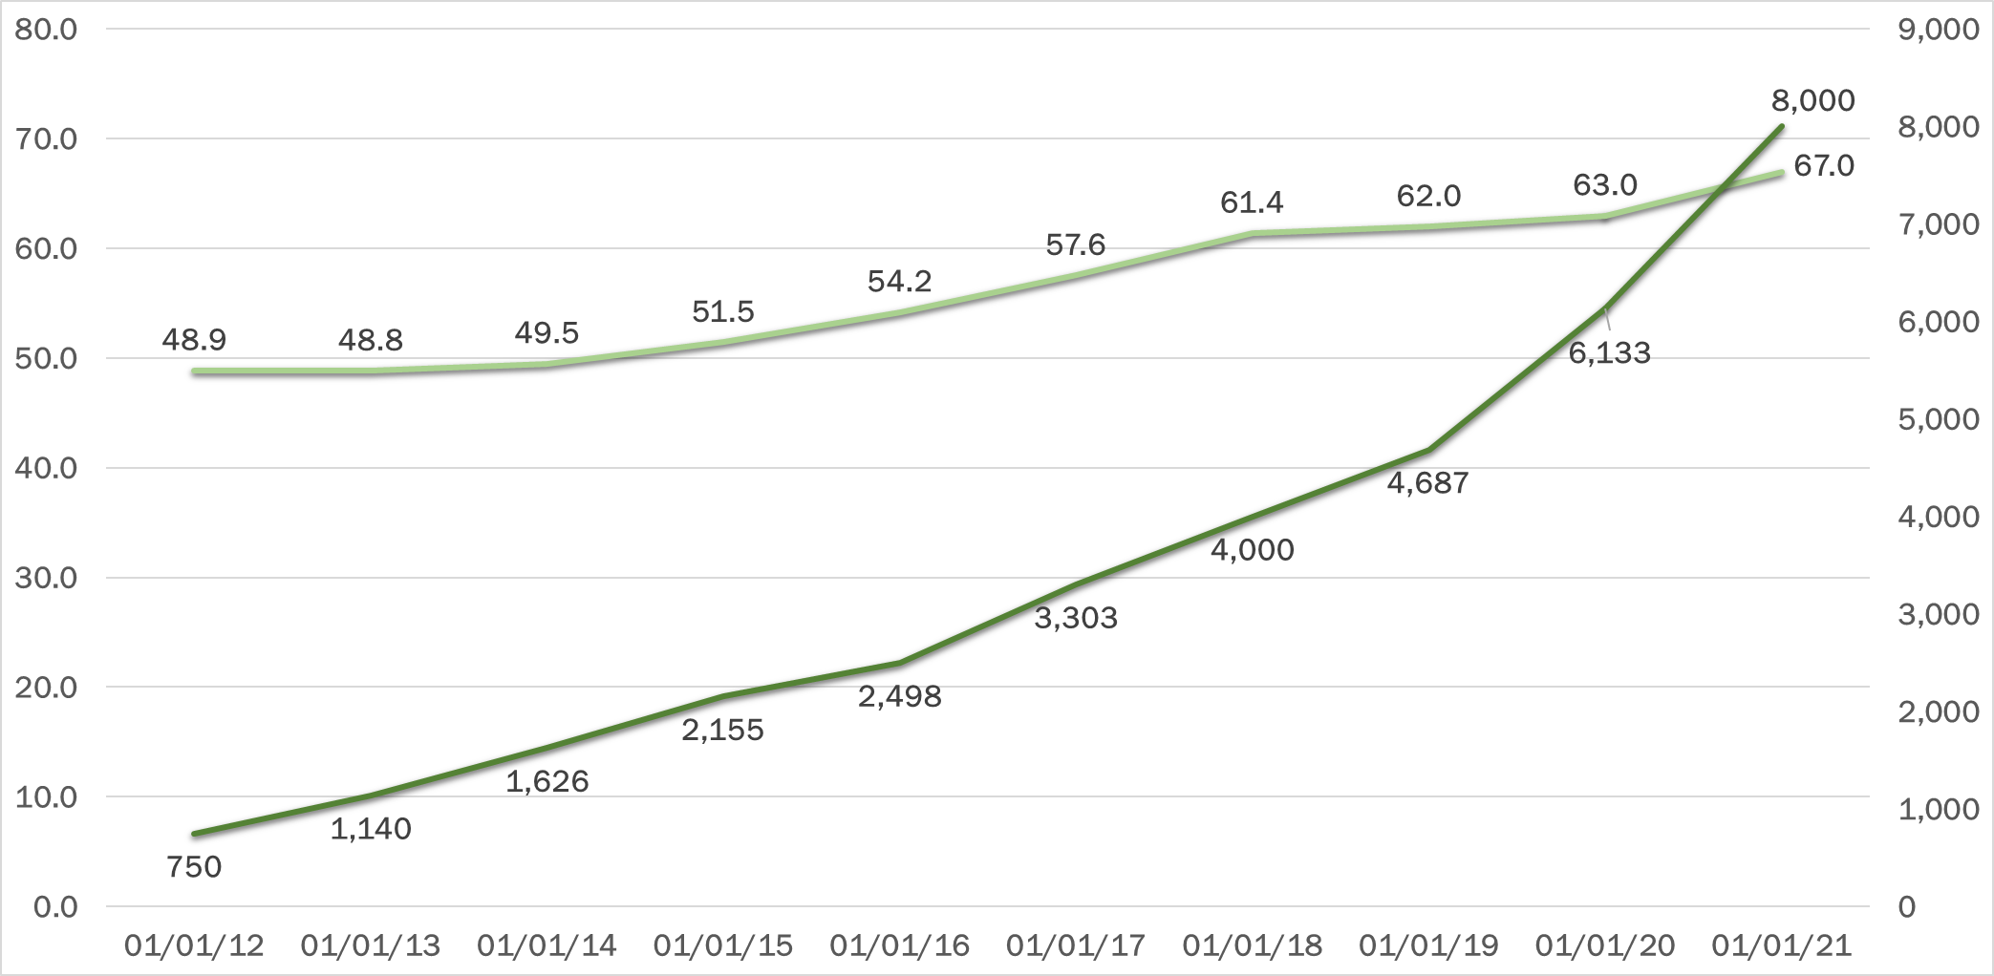
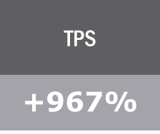
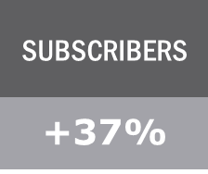
Devops journey in metrics
Subscribers(M)
TPS
Agile Transformation/Early DevOps
DevOps/Service Owners

Slide 7
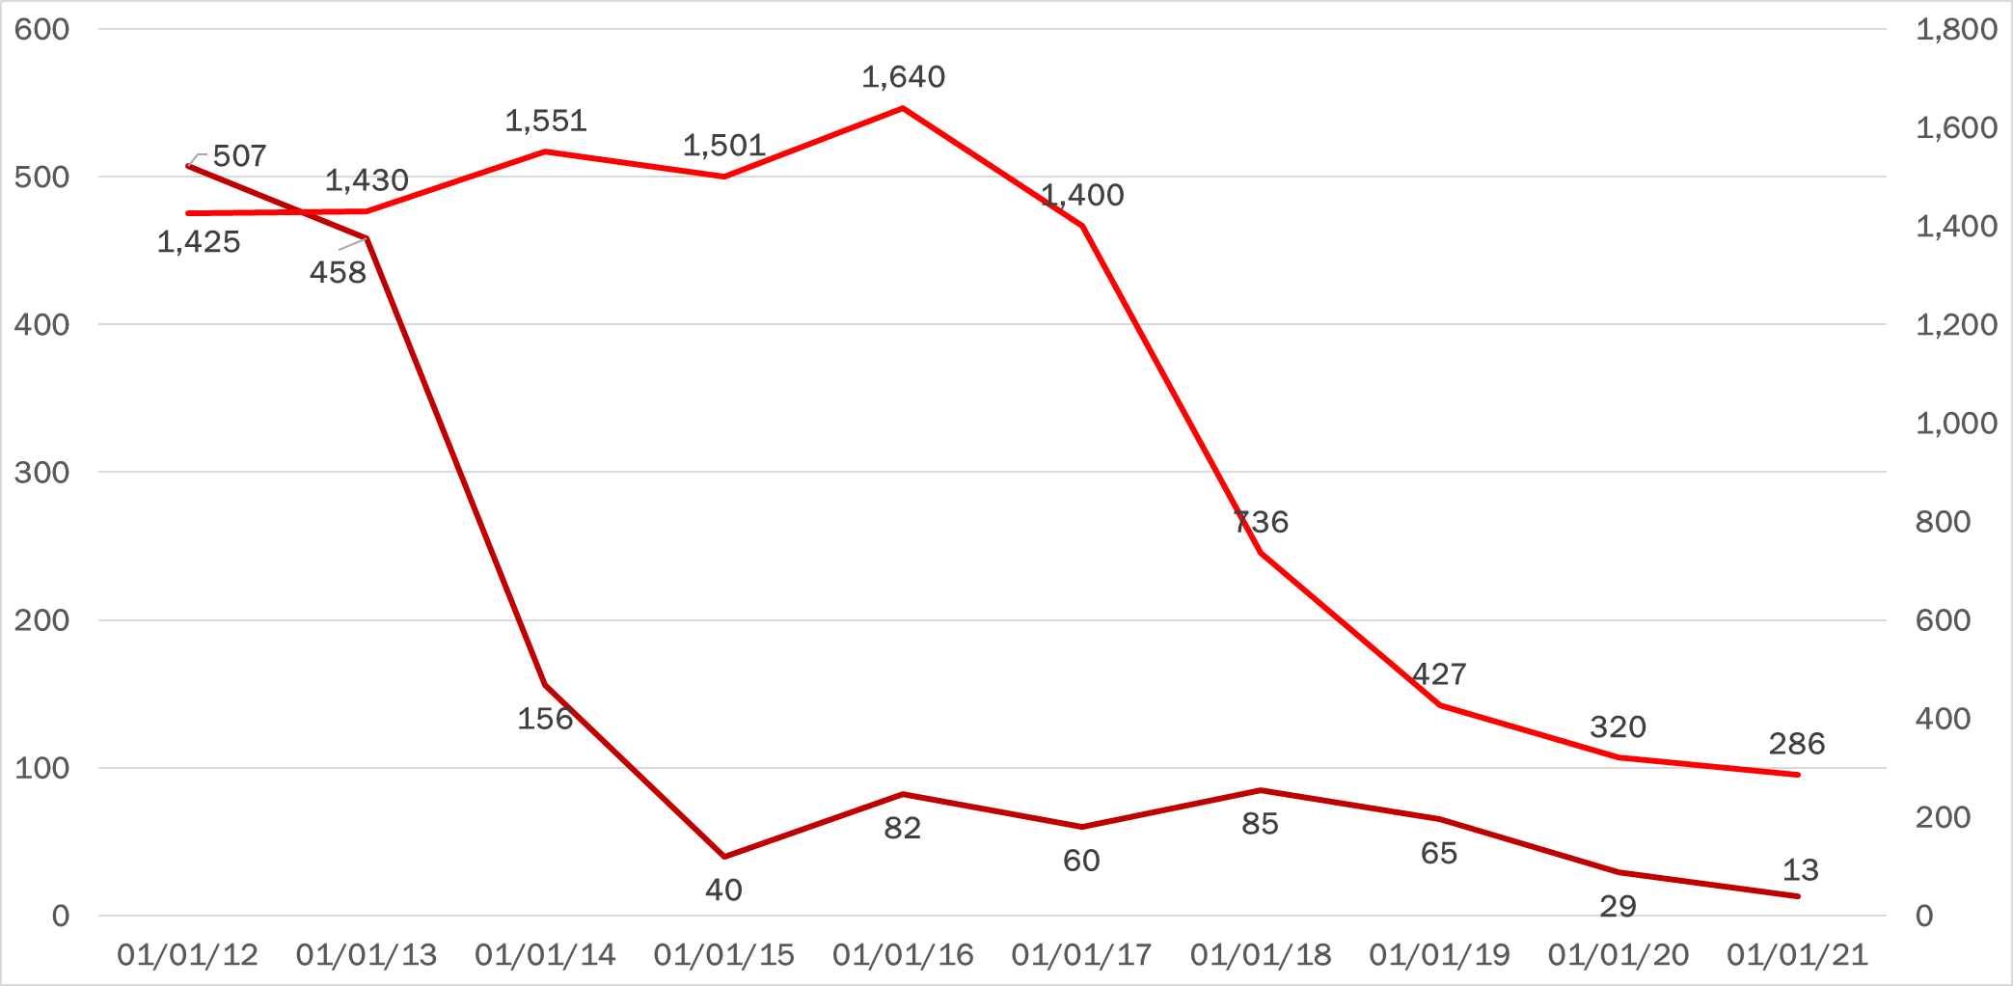
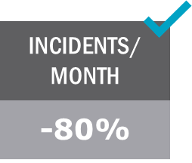
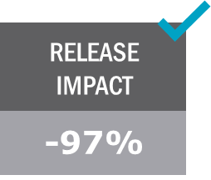
Devops journey in metrics
Incidents/mo.
Release/Impact
Agile Transformation/Early DevOps
DevOps/Service Owners

Slide 8
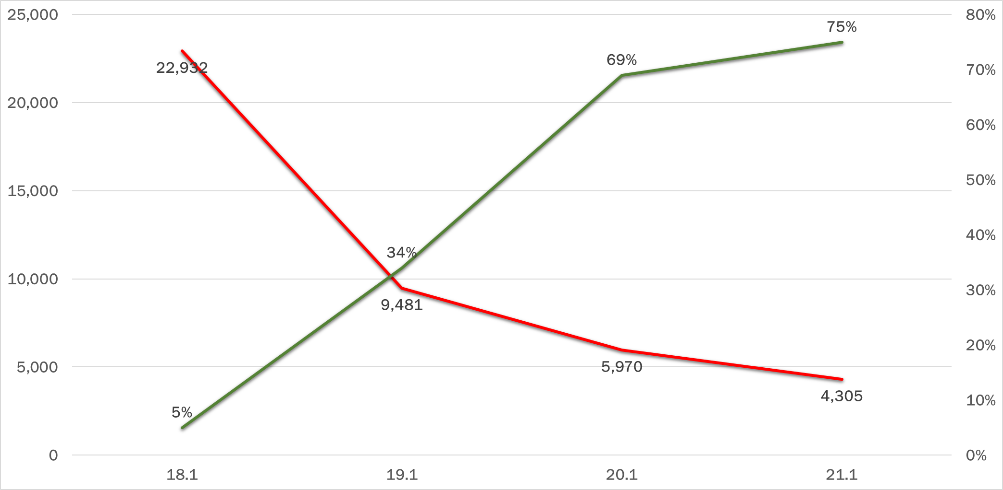
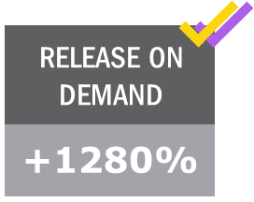
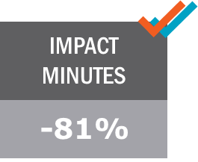
Devops journey in metrics
Release On Demand
Impact Minutes
DevOps/Service Owners

Slide 9

Devops journey in metrics
RELEASE IMPACT
INCIDENTS/ MONTH
SUBSCRIBERS
TPS
-97%
-80%
+37%
+967%
IMPACT MINUTES
RELEASE ON DEMAND
FEATURE CYCLE TIME
eNPS
-81%
+1280%
+500%
-77%
Change Failure %
MTTR
Lead time
Deploy Frequency
Notes:
Scott: 2min

Slide 10


THE STORY OF OUR SERVICE LAYER(SLBOS)
Customers
Revenue Management
30+
Account
Customer
Order
Rating
Billing
Invoicing
Receivable
Inventory
Location
Call Center Representatives
Catalog
Call Center
Reporting
180K
Service Layer
Field Service Management
End Customers
Dispatch
Routing
Schedule
67M
Tech Mgmt
Traffic
Comms
Output Solutions
Application Integrations
Comp
Print
Archival
1K+
Postal
Electronic
Marketing
Notes:
Intro – The Story of SLBOS (Ken)
One of those memories was a decision I made over a decade ago to put Scott in charge of our main services layer.
Release night story. Operations decided to port from Solaris to AIX (recompile). On the night of the release, throughput dropped to a trickle. Customers were livid. I was rotating calls with the CIOs of the three largest Cable companies in the United States.
I knew we had to fix it. I turned to the most competent development leader that I trusted the most. Scott Prugh.

Slide 11
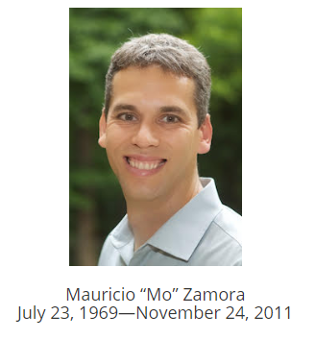
THE STORY OF OUR SERVICE LAYER(SLBOS)
COMMODITY
SIMPLICITY
Our service layer was an anti-pattern for these attributes
RELIABILITY
Notes:
Body - The Story of SLBOS (Scott)
When Ken approached me with the challenge, I was apprehensive.
I turned to my colleague Mauricio Zamora and outlined the problem.
Built on old technology
Complex logic in proprietary 3rd party tool.
High cost of operation.
Config change took hours to implement.
Mauricio told me “how can you possibly make it worse?”

Slide 12
THE STORY OF OUR SERVICE LAYER(SLBOS)
COST PER
TPS
FEATURE DEVELOPMENT
BUILD + DEPLOY
BEFORE
AFTER
BEFORE
AFTER
BEFORE
AFTER
$23
15%
55%
14 hrs.
5 min.
$7,306
SERVER RECYCLE
AUTOMATED TESTS
BEFORE
AFTER
BEFORE
AFTER
45 min.
2 min.
0
~14K
Notes:
What we did…
Rewrite
Shift to Commodity Hardware
Benefits
xxx

Slide 13


THE STORY OF MERGING DEV & OPS
Speed!
Better/faster environments!
Better SR Tools!
We hate CRQs!
Stability! Better code!
Better Agile tools! We hate CRQs!
DEVELOPMENT
OPERATIONS
CUSTOMERS
High quality features, quickly!
CHANGE MANAGEMENT // RELEASE MANAGEMENT // PRODUCTION OPERATIONS // PMO
Notes:
Intro - The Story of Merging Development and Operations (Ken)
Having worked through the SLBOS migrations, we still were not hitting on all cylinders.
We still had Development (reporting to me) and Operations (reporting to another leader in the organization).
Planning work was impossible. Development would commit to work but Operations had a separate list of priorities.
I had to go to the CEO and tell him he had to choose one leader. There should be one organization with cross functional teams.
I felt so strongly that I told him I’d resign if he decided the better leader was my peer. This was a decision he had to make.
In the end, our CEO had the courage to make a difficult decision. He rolled Development and Operations under me.
We reorganized with cross functional teams. Teams were comprised of developers and operations staff. That is when the real fun started.

Slide 14
THE STORY OF MERGING DEV & OPS
SERVICE OWNER
DESIGN
DEVELOP
TEST
OPERATE
SERVICE
DEVOPS TEAM
DEVOPS TEAM
Resource Efficiency
Project-centric
Flow & Knowledge Efficiency
Organized by product/service not projects
Notes:
Body - The Story of Merging Development and Operations (Scott)
This was not a popular decision.
We were asking people to change the way they worked and we defined new expectations.
Developers carried pagers.
Operations people learned to write code.
We had difficult discussions
We committed to helping people learn new skills
Some opted out of the organization (e.g. system admins who didn’t want to learn about automation).

Slide 15
How structure influences behavior and quality
98% of 1600 incidents/month reported handled by L2 ops
92% of these incidents were “quick fixes” by ops
NON-RELEASE
RELEASE
SID Issues
Works in test!
Not in Prod!
One or more offers
Order mismatch
DEVELOPMENT
Invalid equipment
OPERATIONS
1 - CRITICAL
2 - HIGH
3 - MEDIUM
4 - LOW
1 - CRITICAL
2 - HIGH
3 - MEDIUM
4 - LOW
DEV
OPS
Problem management and multi-tiered support(L1→L2→L3) won’t save you.
Notes:
But… We immediately saw massive improvements.
Story of SQL script run to fix out of sync issue.

Slide 16
GROWING LEADERS
10x
LEADER
10x DEVELOPER
Notes:
Intro – Growing Leaders (Ken)
Scott and I have been through many battles. CSG is the third company where we’ve worked together. From our consulting days, to founding a start-up, to working for CSG, Scott and I have shared a strong working relationship built on mutual respect and trust.
During that time, I’ve seen Scott grow. In the early years, Scott was an amazing programmer. The term “10x developer” applied to Scott. He was 10 times as productive as his peers.
Throughout the years, I have challenged Scott with increasing levels of responsibility.
However, there was a time years ago where I told Scott we were reaching the limits of what he could personally do. I told him I need him to evolve from a “10x developer” to a “10x leader”.
Today, I couldn’t be more proud of Scott’s leadership. Not only has he been the catalyst for transformational change but he’s also built a team of amazing leaders – many of whom have either spoken here at DOES or who were pivotal leaders in our transformational journey. (Erica, Steve, Jeremy, Brian)
But rather than have me tell you about the importance of leadership, let me pass it off to Scott.

Slide 17
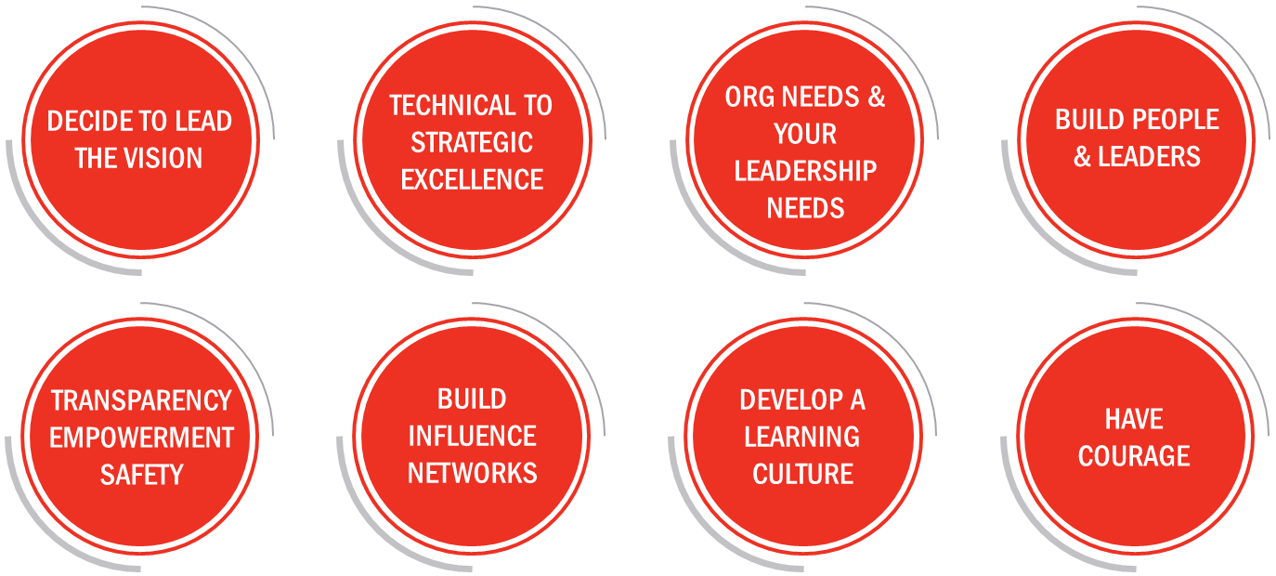
GROWING LEADERS: WHAT WE LEARNED
Notes:
V=VISION
IC=INSPIRATIONAL COMMUNICATION
PR=PERSONAL RECOGNITION
SL=SUPPORTIVE LEADERSHIP
IC=INSPIRATIONAL COMMUNICATION
BUILD SELF AWARENESS
DECIDE TO BE PART OF LEADING THE VISION. UNDERSTAND IF YOU WILL LOVE LEADING.
FUNCTIONAL EXCELLENCE TO STRATEGIC EXCELLENCE
ORG NEEDS & YOUR LEADERSHIP
BUILD PEOPLE & NEXT GEN LEADERS
TRANSPARENCY, EMPOWERMENT & SAFETY
BUILD INFLUENCE NETWORKS: INTERNAL & EXTERNAL. BUILD PURPOSEFUL CONNECTIONS
BUILD A LEARNING CULTURE: SYSTEM THINKING & PROFOUND UNDERSTANDING. A CLIMATE FOR LEARNING IS YOUR COMPETITIVE ADVANTAGE.
HAVE COURAGE: SUCCESS IS NOT INEVITABLE
Climate for Learning
An organization with a climate for learning is one that views learning as an investment
that is needed for growth as opposed to a necessary evil, undertaken only when
required. Research done in other areas, such as finance, shows that a climate for
learning is predictive of performance gains. Our research this year confirmed findings
from early in our research program that a climate for learning positively affects
organizational culture.
Equally important is where organizations expect learning to happen. Are opportunities
for learning and growth provided during work time? In contrast, is learning expected but
not supported, so that employees feel pressure to put in time during evenings and
weekends? These environments ultimately lead to burnout and have disproportionate
and negative effects on underrepresented minorities and people with non-traditional
lifestyles. If you have to care for children or ailing parents, for example—the kind of work
that disproportionately falls to women—creating time for education is much more
difficult than for those who can devote their spare time to work and training.
Having a strong climate for learning can be a strategic advantage for teams and organizations.
As we work in increasingly complex environments with changing requirements, a culture that
excitedly embraces change and jumps at the opportunity to learn new things will
ultimately excel. These teams thrive during change, whether that is a technology
transformation, organizational change, or rapidly changing customer demands and markets.

Slide 18
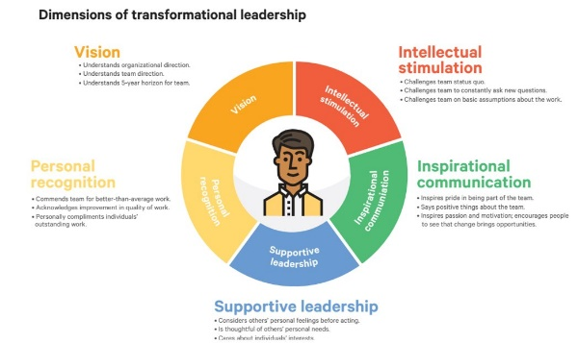
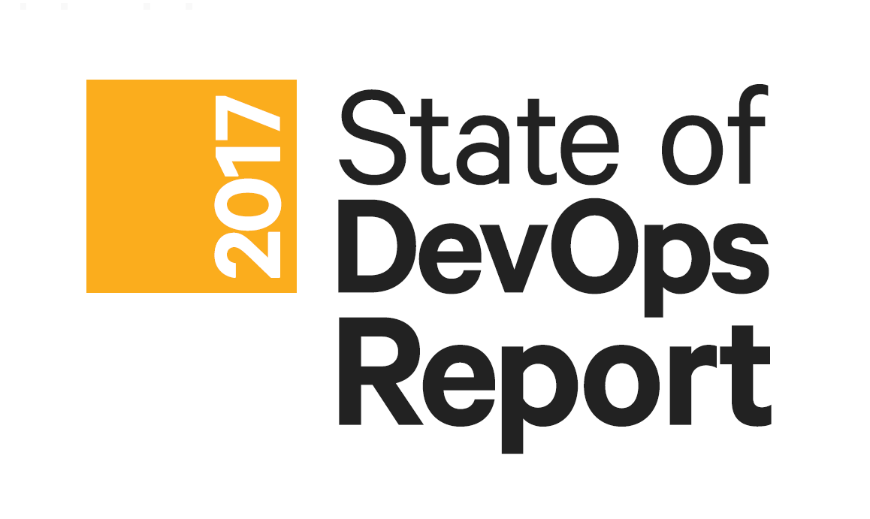
GROWING LEADERS: WHAT WE LEARNED
V
PR
IC
SL
SL
IC
SL
IS
IS
VISION
INTELECTUAL STIMULATION
INSPIRATIONAL COMMUNICATION
SUPPORTIVE LEADERSHIP
PERSONAL RECOGNITION

Slide 19

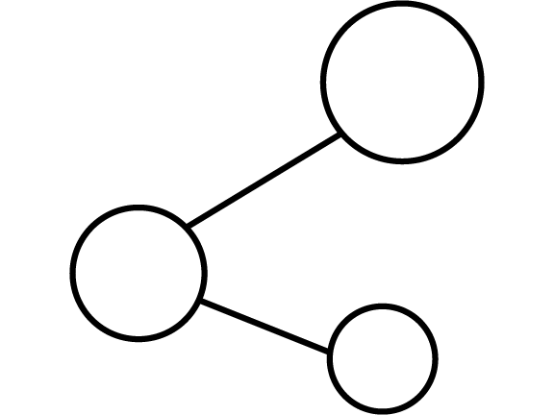
WORKING WITH EXECUTIVE LEADERSHIP
STEP 1:
STEP 2:
Make the correlation for them.
Build credibility and trust.
Notes:
Working with Executive Leadership (Ken)
Two months ago, I met with Scott and I met with Gene and described a challenge many of you may face. The challenge is how to convince executive leadership to invest in DevOps.
Remember at the beginning of our talk how I told you how I’m measured. My success and my compensation are tied to revenue growth, profitability, and operational performance.
The problems many forward thinking leaders encounter is many executives don’t think in terms of flow metrics, feedback loops, and telemetry. Often there isn’t a direct correlation between a reduction in technical debt and the bottom line.
Step 1 – Make the Correlation for Them.
Share the State of DevOps Report – The report produced by Nicole Forsgren, Jez Humble and Gene Kim did a wonderful job studying the effect of specific business practices and the correlation with improved organizational performance.
The research statistically shows that improvements in throughput and stability drive profitability, market share, customer satisfaction and productivity.
Step 2 – Build Credibility and Trust
Get some quick wins to build your credibility. Don’t start by boiling the ocean. We talked about the SLBOS project. Truth be told, it took longer to deliver than we anticipated. However, the savings dwarfed our original expectations. When we stopped tracking the business case, we estimated the project saved us $18m/year.
Trust – Jump Off

Slide 20

The recipe for success
SOFTWARE
DELIVERY
PERFORMANCE
ORGANIZATIONAL
PERFORMANCE
Notes:
DORA is a company founded by industry thought leaders Nicole Forsgren, Jez Humble, and Gene Kim. Every year, they produced a report called the State of DevOps. It is the largest and long running research that studies the effects of specific business practices and the correlation with improved organizational performance. Not surprising, there is a direct correlation between the Software Delivery Performance of a company and the Organizational Performance.
More specifically…
DORA is a company founded by industry thought leaders Nicole Forsgren, Jez Humble, and Gene Kim. Every year, they produced a report called the State of DevOps. It is the largest and long running research that studies the effects of specific business practices and the correlation with improved organizational performance. Not surprising, there is a direct correlation between the Software Delivery Performance of a company and the Organizational Performance.
More specifically…

Slide 21




The recipe for success
PRODUCTIVITY
PROFITABILITY
THROUGHPUT
STABILITY
TODO: Cassidy to replace icons and be consistent with earlier slides
CSB: I ended up not using icons in slides 6 and 11 (where we were going to coordinate), so I just created a consistent look and feel with slide 4. Let me know if there’s something further we want to do here.
MARKET SHARE
CUST. SATISFACTION
Notes:
More specifically, research has shown that those companies that can maximize, throughput and stability are the ones that

Slide 22

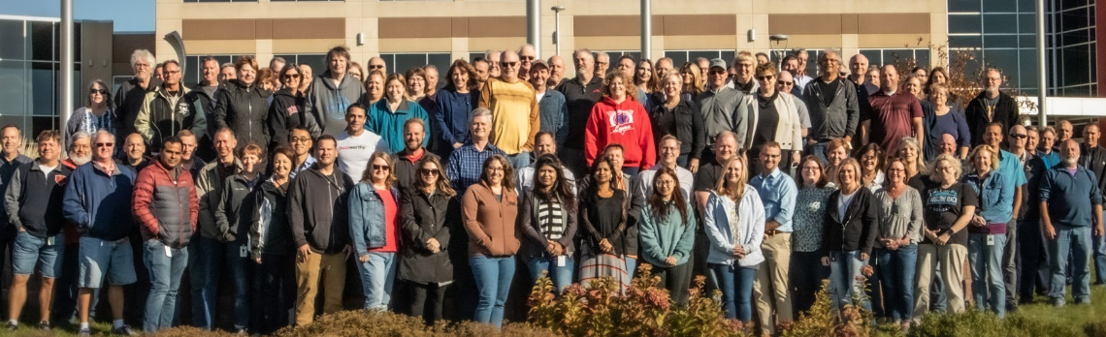
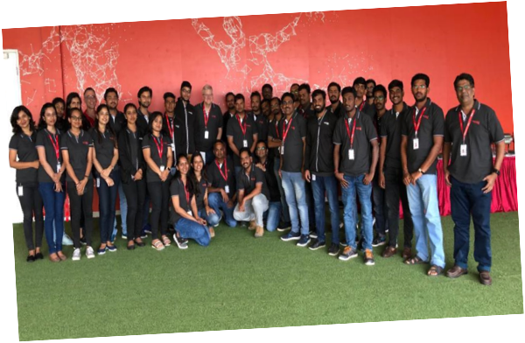






We should refresh this with a new set of pictures.
KMK Thought: We have headshots of key leaders in Scott’s organization. I think we should use the headshots of the key leaders (Morrison, Barr, VanHaren, Clark) and we should have two group shots (the big one from Omaha on this slide, another big one of Bangalore).
THANKS
Shape a Better World!
We should add Ken Heatherly in here.
KEN: TODO
Notes:
Ken: I usually bring in a people slide to thank folks at CSG. I have gotten very positive feedback all along the way.

Slide 23
Help We Are looking for
“CAPACITY” FORECASTING AND “ESTIMATION” & WISHFUL THINKING
PORTFOLIO LEVEL WIP CONSTRAINTS
(STOPPING FEATURE TETRIS)
IMPROVING INTAKE LEADTIME WITH TRADATIONAL IT MINDSETS
CREATING CAPACITY FOR “BACKLOG SWARMING”
TODO: Ken to think through what executive leadership needs.
Notes:
Scott: Speak

Slide 24
scratch

Slide 25
GROWING LEADERS: WHAT WE LEARNED
TECHNICAL TO STRATEGIC EXCELLENCE
ORG NEEDS & YOUR LEADERSHIP NEEDS
DECIDE TO LEAD THE VISION
BUILD PEOPLE & LEADERS
TRANSPARENCY EMPOWERMENT
SAFETY
BUILD INFLUENCE NETWORKS
DEVELOP A LEARNING CULTURE
HAVE
COURAGE
Notes:
V=VISION
IC=INSPIRATIONAL COMMUNICATION
PR=PERSONAL RECOGNITION
SL=SUPPORTIVE LEADERSHIP
IC=INSPIRATIONAL COMMUNICATION
BUILD SELF AWARENESS
DECIDE TO BE PART OF LEADING THE VISION. UNDERSTAND IF YOU WILL LOVE LEADING.
FUNCTIONAL EXCELLENCE TO STRATEGIC EXCELLENCE
ORG NEEDS & YOUR LEADERSHIP
BUILD PEOPLE & NEXT GEN LEADERS
TRANSPARENCY, EMPOWERMENT & SAFETY
BUILD INFLUENCE NETWORKS: INTERNAL & EXTERNAL. BUILD PURPOSEFUL CONNECTIONS
BUILD A LEARNING CULTURE: SYSTEM THINKING & PROFOUND UNDERSTANDING
HAVE COURAGE: SUCCESS IS NOT INEVITABLE

